Slide 1





Intrinsic Universality in Tile Self-Assembly Requires Cooperation
Pierre-Etienne Meunier Matthew J. Patitz
Scott M. Summers Guillaume Theyssier
Damien Woods Andrew Winslow

Slide 2
Tile

Slide 3
Glues

Slide 4
Strength-2
Strength-1

Slide 6
×∞
×∞
×∞
×∞
×∞
Temperature

Slide 12
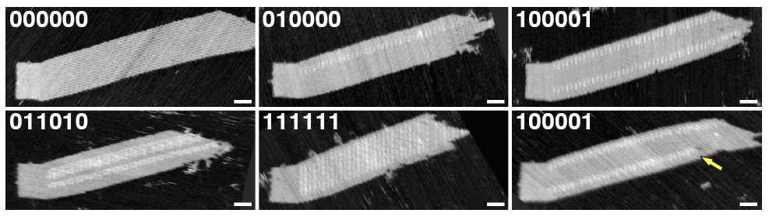
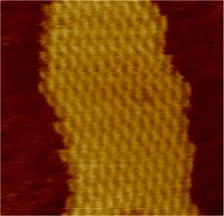
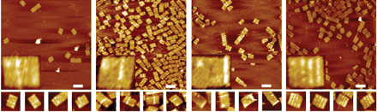
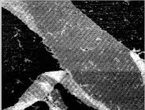
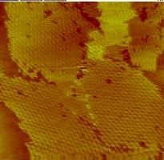
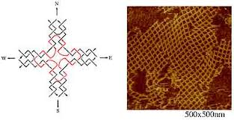
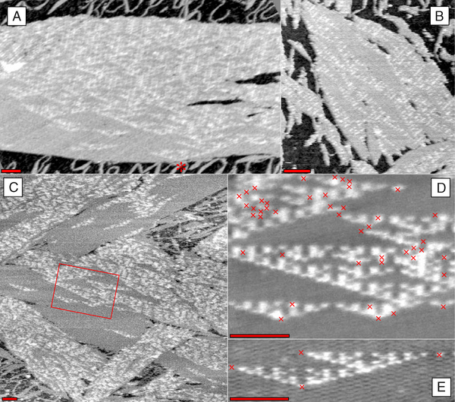
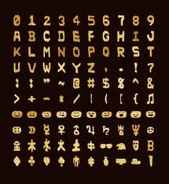
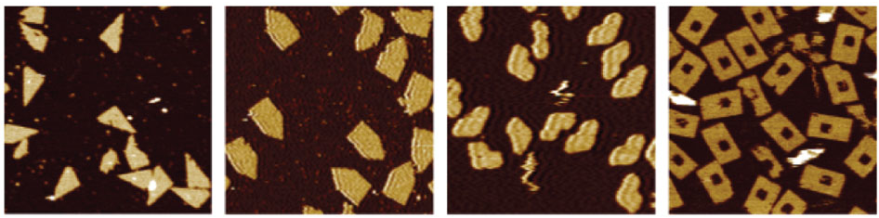
Self-assembling tiles: a real thing

Slide 13
0
0
0

Slide 14
0
0
1

Slide 15
0
1
0

Slide 16
1
1
1

Slide 17
Temperature-2 systems can require
a tile to use cooperative bonds.

Slide 18
Temperature-1 systems do not
have cooperative bonds.

Slide 19
Are temp-1 and temp-2 systems equally powerful?
Conjectured not.

Slide 20
What does “power” mean?
Power = ability to simulate.

Slide 21
Simulation Definition
1. Pick scale factor k.
2. Pick special marker tiles to encode tile type of each macrotile.
3. Tiles only in macrotiles encoding tiles and neighbors.
4. Macrotiles are placed in same order as simulated tiles.

Slide 22
Simulation Definition
1. Pick scale factor k.
2. Pick special marker tiles to encode tile type of each macrotile.
3. Tiles only in macrotiles encoding tiles and neighbors.
4. Macrotiles are placed in same order as simulated tiles.

Slide 23
Simulation Definition
1. Pick scale factor k.
2. Pick special marker tiles to encode tile type of each macrotile.
3. Tiles only in macrotiles encoding tiles and neighbors.
4. Macrotiles are placed in same order as simulated tiles.

Slide 24
Simulation Definition
1. Pick scale factor k.
2. Pick special marker tiles to encode tile type of each macrotile.
3. Tiles only in macrotiles encoding tiles and neighbors.
4. Macrotiles are placed in same order as simulated tiles.

Slide 25
Simulation Definition
1. Pick scale factor k.
2. Pick special marker tiles to encode tile type of each macrotile.
3. Tiles only in macrotiles encoding tiles and neighbors.
4. Macrotiles are placed in same order as simulated tiles.

Slide 26
Simulation Definition
1. Pick scale factor k.
2. Pick special marker tiles to encode tile type of each macrotile.
3. Tiles only in macrotiles encoding tiles and neighbors.
4. Macrotiles are placed in same order as simulated tiles.

Slide 27
Given
Encoded as
Mixed with
Assembles
assembling
at

Slide 28
Given
Encoded as
Mixed with
Assembles
assembling
at

Slide 29
This system is instrinsically universal.
Given
Encoded as
Mixed with
Assembles
assembling
at

Slide 30

Intrinsic universality:
simulating a whole class of things

Slide 31
There is a temp-2 system that is
intrinsically universal for all tile systems!

Slide 32

There is a temp-2 system that is
intrinsically universal for all tile systems!

Slide 33

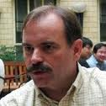

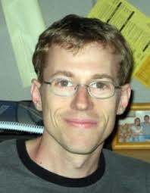


There is a temp-2 system that is
intrinsically universal for all tile systems!
Dave Doty
Jack Lutz
Robbie Schweller
Scott Summers
Matt Patitz
Damien Woods

Slide 34
Is there a temp-1 system that is
intrinsically universal for all tile systems?
No.
Is there a temp-1 system that is
intrinsically universal for temp-1 systems?
Yes (but 3D).

Slide 44
Keystone

Slide 45
Flag

Slide 46
18-tile temp-2 system
assembles
a
c
b
For all a, b, c ≥ 0

Slide 47
We show no temp-1 system
simulates temp-2 system

Slide 48
Breaking any simulation

Slide 49
Breaking any simulation

Slide 50
Breaking any simulation

Slide 51
Breaking any simulation

Slide 52
Breaking any simulation

Slide 53
Breaking any simulation

Slide 54
Breaking any simulation

Slide 55
Breaking any simulation

Slide 56
Breaking any simulation

Slide 57
Breaking any simulation

Slide 58
Breaking any simulation

Slide 59
Breaking any simulation

Slide 60
Any temp-1 system that assembles
a
c
b
For all a, b, c ≥ 0
also assembles
a
a
or
b
b
For some a, b ≥ 0
For some a, b ≥ 0

Slide 61
No temp-1 system simulates
and its assembly of
a
c
b
For all a, b, c ≥ 0

Slide 62
Summary
There exists a temp-2 system known to be intrinsically universal for all tile systems.
We show no such temp-1 system exists.
And there is a 3D temp-1 system intrinsically universal for temp-1 systems.

Slide 63
Open Problem
Is there a 2D temp-1 system intrinsically universal for 2D temp-1 systems?
Conjecture: no.

Slide 64


Thank you
Pierre-Etienne Meunier
Matt Patitz
Scott Summers
Guillaume Theyssier
Damien Woods
National Science Foundation grants:
CCF-1219274, CCF-1117672, CCF-0830734, CBET-0941538, 0832824 (The Molecular Programming Project), CCF-1219274, and CCF-1162589.
Agence Nationale de la Recherche grant ANR-09-BLAN-0164

